Slide 1
Investigating Wittgenstein
A Revolutionary Conversation
with Lois Holzman
(Created 2015)

Slide 2
Ludwig Wittgenstein (1889-1951)
Wittgenstein was a unique, eccentric and brilliant 20th century philosopher who took apart nearly every concept that underlies how psychology, education and medicine are done—and put just a few of them back together.
His writings on language, logic, learning and looking—hard but fun!—are an integral part of the psychology of becoming.
Wittgenstein’s reflections are valuable tools for examining some of our most basic assumptions—like causality, essence, meaning, and the very nature of language and thought.
Psychologists and educators—not to mention, the rest of us—need to seriously examine, question and play with our assumptions and our language.

Slide 3
Here are some Wittgenstein quotes to examine,
question
and play with …

Slide 4
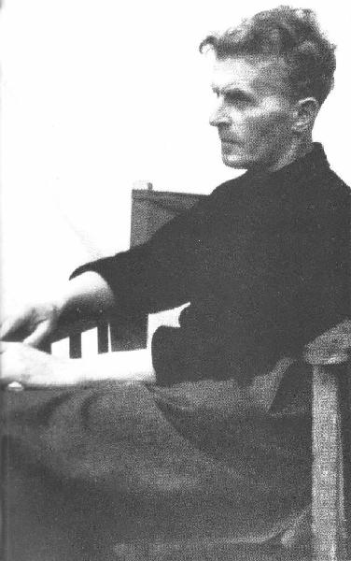
The way to solve
the problem you see in life is to live in a way that will make what is problematic disappear.

Slide 5
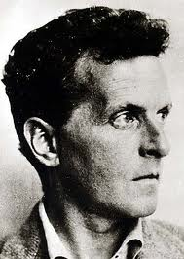
Philosophy is a battle against the bewitchment of our intelligence by means of our language.

Slide 6
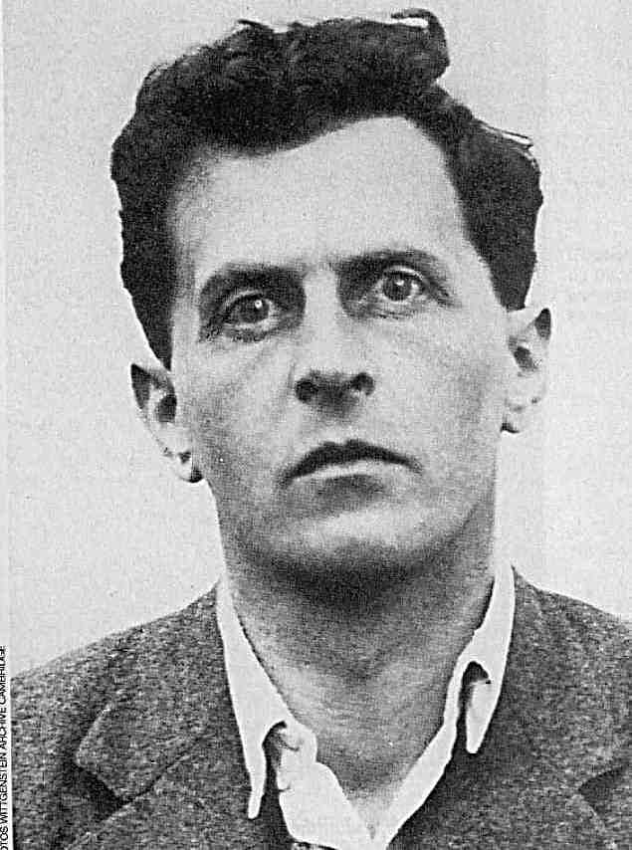
The term “language-game” is meant to bring into prominence the fact that the speaking of language is part of an activity, of a form of life.

Slide 7
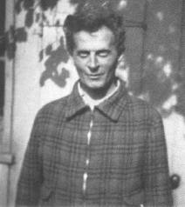
What I do is suggest, or even invent, other ways of looking. I suggest possibilities of which you had not previously thought. You thought that there was one possibility, or only two at most. But I made you think of others. Furthermore, I made you see that it was absurd to expect the concept to conform to those narrow possibilities. Thus your mental cramp is relieved, and you are free to look around the field of use of the expression and to describe the different kinds of uses of it.
Notes:
I shall in the future again and again draw your attention to what I shall call language-games. These are ways of using signs simpler than those in which we use the signs of our highly complicated everyday language. Language-games are the forms of language with which a child begins to make use of words. The study of language-games is the study of primitive forms of language or primi-tive languages. If we want to study the problems of truth or falsehood, of the agreement and disagreement of propositions with reality, of the nature of assertion, assumption and question, we shall with great advantage look at primitive forms of language in which these forms of thinking appear without the confusing background of highly complicated processes of thought. When we look at such simple forms of language the mental mist which seems to enshroud our ordinary use of language disappears. We see activities, reactions, which are clear-cut and transparent. (1965, BBB, p. 17)

Slide 8
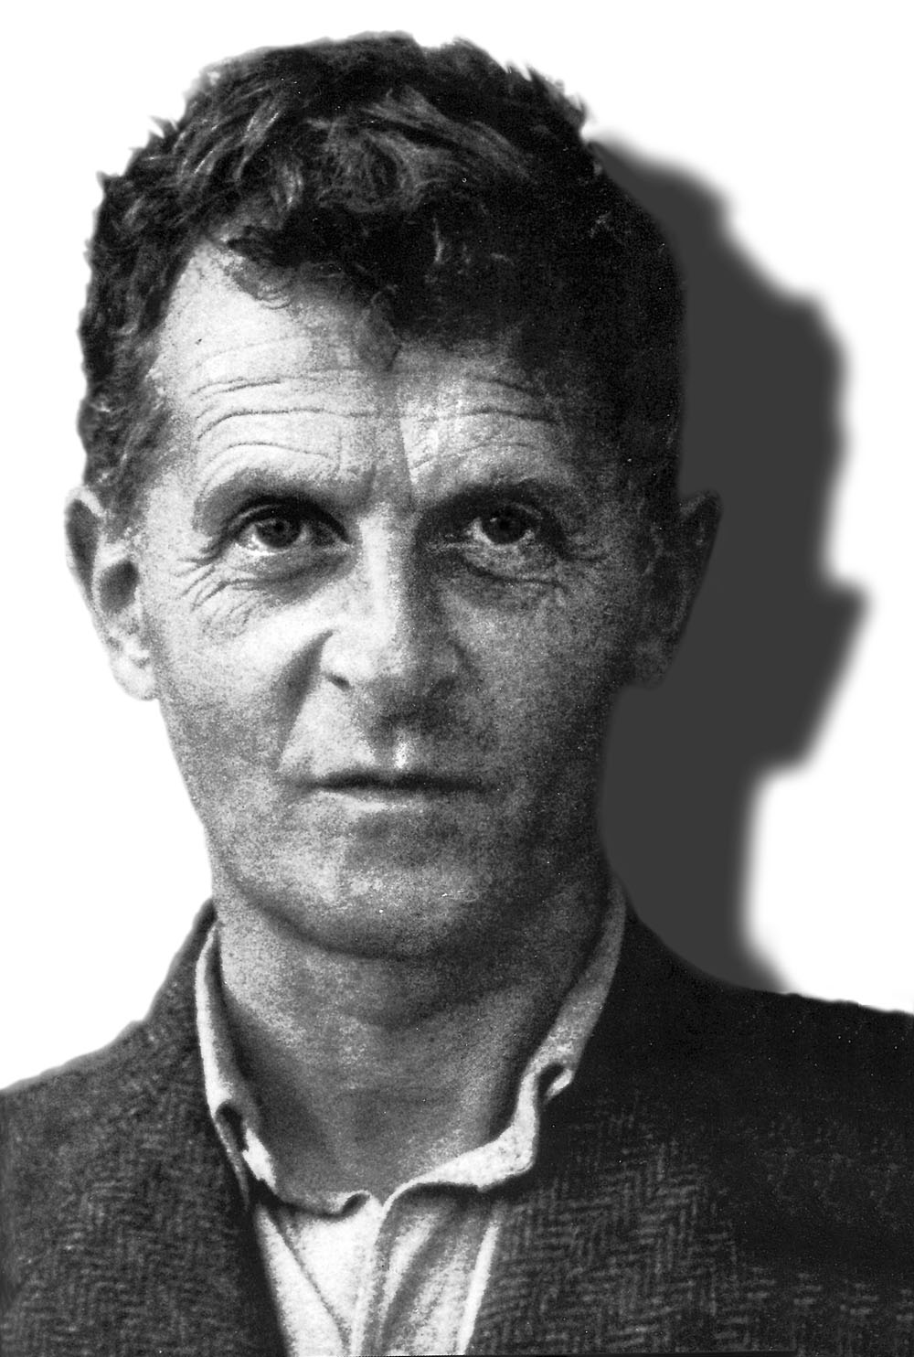
Try not to think of understanding as a 'mental process' at all. For that is the expression which confuses you.

Slide 9
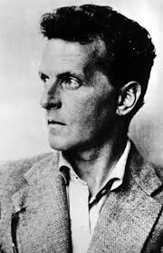
An organism might come into being even out of something quite amorphous, as it were causelessly; and there is no reason why this should not really hold for our thoughts, and hence for our talking and writing.

Slide 10
There is nothing more stupid than the chatter about cause and effect in history books; nothing is more wrong-handed, more half-baked.—
But what hope could anyone have of putting a stop to it just by saying that? (It would be like my trying to change the way women and men dress by talking.)

Slide 11
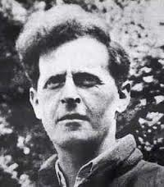
What should we gain by a definition, as it can only lead us to other undefined terms?

Slide 12
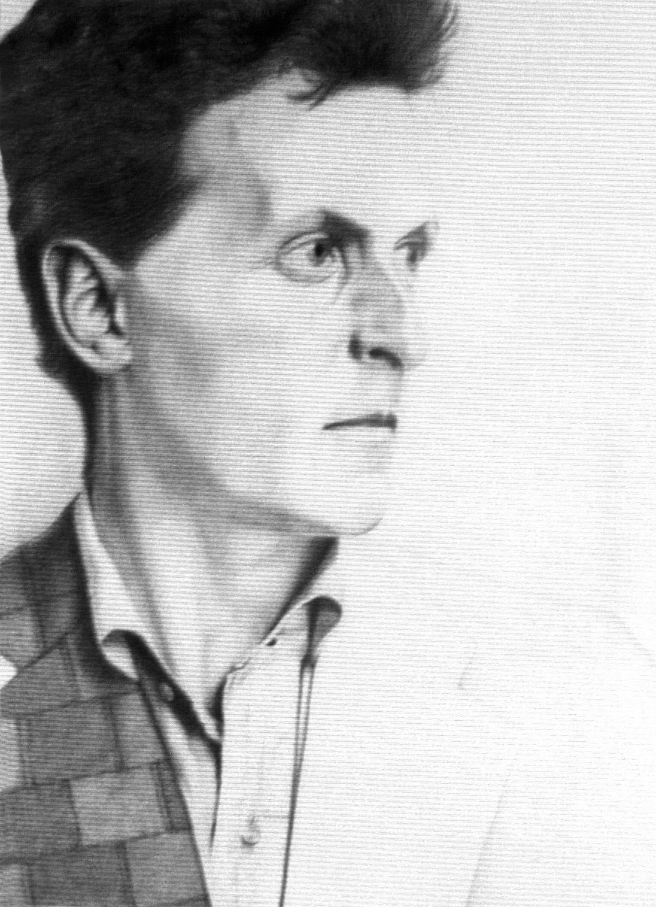
One is often bewitched by a word. For example, the word “know.”

Slide 13
Want More?
Read all chapters of The Overweight Brain: How Our Obsession with Knowing Keeps Us from Getting Smart Enough to Make a Better World at http://loisholzman.org.
Wittgenstein’s masterpiece, Philosophical Investigations, is available FREE online at
http://gormendizer.co.za/wp-content/uploads/2010/06/Ludwig.Wittgenstein.-.Philosophical.Investigations.pdf
Watch the video of contemporary philosopher John Searle discussing Wittgenstein at
https://www.youtube.com/watch?v=qrmPq8pzG9Q&feature=PlayList&p=BA11F92930FBA44D&index=0&playnext=1

